Slide 1
Resonant Cognitive Interweaves: From the Gestalt Empty Chair to the Healing Power of Music & Lyrics
Donald F. deGraffenried, LCSW
4th EMDR Asia Conference – Bangkok, Thailand
January 2 – 5, 2020

Slide 2
Clinical Background:
EMDR Trained in 1999 by Roger Solomon, Ph.D., Boscawen, NH
Have worked with TR/HAP since 2006 as a Facilitator and now as a Senior Trainer for the past five years
Twice trained by Francine Shapiro at Sea Ranch, Calif. to be Part I and Part II Trainer
TRN Coordinator for the Greater New Haven TRN – pro bono EMDR with homicide survivors and victims of other violence crimes referred by the New Haven Police Department
Started brief treatment, EMDR program for homicide survivors at Dixwell Newhallville Community Mental Health Services in New Haven, CT, USA
Served on the EMDRIA Board of Directors for three years
Developed Visual Assessment Tool, used with the Recent Event Protocol to gather the multiple targets without the client going above the “window of tolerance”

Slide 3
Making the Connections:
Cognitive interweave plateaus – brief review
Perls & Shapiro meet at Starbucks & merge their work
Resonance & biofields
Musical lyrics as cognitive interweaves !
Practicum
What do Francine Shapiro, Fritz Perls Stevie Wonder, Ray Charles, Gloria Gaynor & George Harrison have in common?

Slide 4
Apprehensions About Cognitive Interweaves
How do I find the right one?
What if I use the wrong Cognitive Interweave?
What if the Cognitive Interweave does not work?
Is creation the Cognitive Interweave an “art or science”?
Do I need a “master list”?
Interweaves sometimes make me nervous.

Slide 5
What is a Cognitive Interweave?
A brief statement or question by the clinician to the client during blocked, inefficient processing or when you want to accelerate processing
Looping
Running out of time
Emotional distress +
To support continued progress

Slide 6
What are they continued………
Statement, question, suggestion or direction by the clinician
An “offering” that mimics/stimulates spontaneous processing
Client may be helped to to evoke, imagery, thought or movement
Obtaining a new perspective, back “on the tracks” of active processing and desensitization

Slide 7
Cognitive Interweave Plateaus
Responsibility/Defectiveness
Present with almost all victims of a violent crime
Finding appropriate responsibility – the most common NC in Phase III
Look for survivor guilt
Helping the shift from child vs. adult perspective

Slide 8
Plateaus Continued:
Safety/Vulnerability
Supporting present time orientation
High level of fear, potential for “looping”
Use of grounding techniques to maintain effective dual attention in desensitization
Notice “window of tolerance”/maintain optimal processing

Slide 9
Plateaus Continued:
Power/Control (Choices)
Solution based/making better choices
Insoo Kim Berg, MSW
Internal vs. external locus of control
What choices do they have?
Making amends/balancing the scale

Slide 10
Offering the Cognitive Interweave:
Say the CI at the beginning of the set
Do not wait for the clients answer
Provide BLS
“Take a breath, let it go, what do you get now?”
In addition:
You can restate the CI, during the BLS if you feel like this will be supportive and helpful for your client.
Watch your client and listen for the impact of the CI

Slide 11
Witnessed Two Attempts at Suicide - audio tape
Reassessment SUDS = 5
Support
CI - Train metaphor/Distancing strategy
Back To Target
CI – “Ability to help it to fade”
CI – “Trying to make amends”
CI – “The capacity for forgiveness” Spiritual
CI – “Notice the strength that is in your compassion – a special thing.”

Slide 12
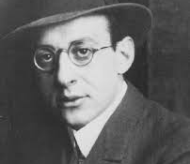
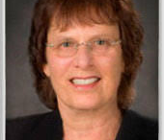
Fritz Perls & Francine Shapiro
Meet at Starbucks

Slide 13
A Spirited Discussion:
Fritz Perls:
Gestalt is the way !
The “Empty chair” is the best approach !
Francine Shapiro:
Cognitive Interweaves with BLS are the best approach !
Go with that !

Slide 14

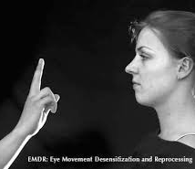
What was their compromise?

Slide 15
Irena
45 year old Russian, Muslim woman, married with one child
PTSD related to recent car accident
Lost an infant at 4 weeks
Using Recent Event Protocol with the Visual Assessment Tool
She becomes highly distressed, feeling guilt about the suffering of the baby

Slide 16
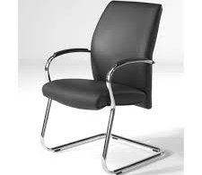
Plateau of Responsibility:
Picture, visualize or imagine your Imam in the chair……
Just notice how he looks, just notice…….
“What would your Imam say to you now about what happened”
Do long set of BLS.
“Take a breath, let it go, what do you get now?”

Slide 17
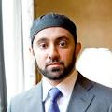
Imam from her mosque
Give the client time to connect with the visual cognitive interweave – “remember picture, visualize or imagine”
Used as suggestions from hypnotherapy
Ok to repeat the cognitive interweave during BLS

Slide 18
Ronald
49 year old, separated man, in recovery from alcoholism
Identified targets are death of his infant brother in a house fire & suicide of his adult brother
Using 8 Phase Processing
Looping with: “Its my fault”
Strong degree of emotion

Slide 19
Plateau of Responsibility
“Picture, visualize or imagine your sponsor in the empty chair”….
Just notice how he looks, just notice……
What would your sponsor say to you now about what happened?
Do long set of BLS
“Take a breath, let it go, what do you get now?”

Slide 20

Notice your sponsor
It may be helpful to spend more time in a debrief, in between sets of BLS
Also, save time at the end of the session to do a more extensive debrief with your client

Slide 21
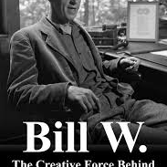
Co founder of AA – Bill W.
“Picture, visualize or imagine Bill W in the chair.”
“What would Bill W. say to you now?”

Slide 22
William
51 year old divorced male, with one child
Target is the court room, distress of a contested divorce, he worked there as an attorney
Presenting with a high degree of emotional distress and looping
Also is very self critical and feels defective

Slide 23
Plateau of Responsibility
“Picture, visualize or imagine your friend from law school in the empty chair”….
“Just notice how he looks, just notice……”
“What would your friend say to you now about what happened?”
Do long set of BLS
“Take a breath, let it go, what do you get now?”

Slide 24
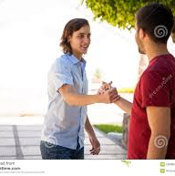
Friend from Law School
Strength & solution oriented
“I remember what Bobby said”
Connects to positive life experience
Contains “positive self talk”

Slide 25
Robert
55 year old divorced male, with two children
Target is 4th grade , when he was verbally abusive of a deaf boy in his class
Presenting with significant distress & feeling “there is no way to make it better.
Moving to a solution based perspective

Slide 26
Plateau of Power/Choices
“Picture, visualize or imagine the child from your 4ht grade class in the empty chair”….
“Just notice how he looks, just notice……”
“What would you say to him now to make amends?”
Do a long set of BLS
“Take a breath, let it go, what do you get now?”

Slide 27
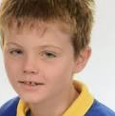
Classmate from School
“I want to make amends”
Talks to him in the chair at length………..
“What would the pastor from your church say to you now about how to help?”
Working the 12 Steps from AA
Takes a “balancing the scale” action during the session

Slide 28
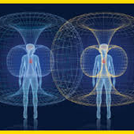
Why Musical/Lyrics Cognitive Interweaves?
The universal positive impact of lyrics……
We all have a collective memory of thousands of songs.
Lyrics connect to emotions
Lyrics can be linked to the domain where the client is stuck

Slide 29
Cognitive Interweaves &
Musical Lyrics…………….
Audio tape
CI – “So just notice whatever you want to get rid of and go with that.”
Musical CI - “Bear with me, makes me think of a song”: “Shout, shout let it all out, these are the things, I can do without.........................”
Client –”Thinking about those words, it is good to let it out”….
Go With That…………..
CI – “Notice that good shift, notice your ability to transform this experience.”

Slide 30
Healing at the Speed of Sound by
Don Campbell
Alex Doman
The rich neural resonance between music, emotion and personal identify have been demonstrated via magnetic resonance imaging at the University of California.
The prefrontal cortex responds and is especially active when the song has an autobiographical relevance, touching on our own memories or sense of ourselves.
Musical CI Lyrics + BLS = Healing at the Speed of Sound

Slide 31
Energy Field &
Morphogenetic Field
Energy field – the electromagnetic radiation emanating from the physical body.
Morphogenetic field – an energy field that holds memory across space and time and is the spiritual substance from which development can unfold.

Slide 32
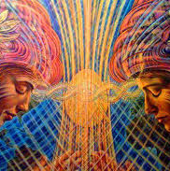
Irene Siegel, Ph.D.:
“The Sacred Path of the Therapist”
Shamans - are ancestral teachers, guides to non-ordinary realms of consciousness, healing by connecting to elemental energies.
Therapists - can also connect to this experience, respecting the healing power of silent space in the session, moments in which sacred energy emerges.

Slide 33
R. Anderson:
Resonance
Sympathetic resonance – when a cello string is played on one side of the room, the same string on a cello on the opposite side of the room, begins to vibrate.
This produces a sound in resonance with the original string, a sympathetic resonance that becomes interpersonal.

Slide 34
Daniel Siegel: “The Mindful Therapist”:
“Resonance makes two a part of one system, at least temporarily. Attuning to ourselves within mindful states, we have the observing and experiencing self in resonance. Attuning to others, we open ourselves to the profound adventure of two as a part of one interactive whole.”

Slide 35
Lynn McTaggert: “The Field”
Biofield – extends beyond the body and into the environment, transcending time and space, holding memory and influencing evolution.

Slide 36
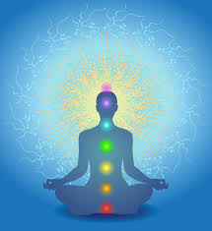
Connecting to Mindfulness to Discover Cognitive Interweaves
Mindfulness – focusing awareness on a moment by moment experience, being present and not attached to expectations or outcomes

Slide 37
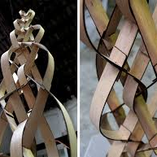
No Damage Done
Remember - if you use a cognitive interweave and it is not helpful or effective, it does no damage to the client.
Use more than one cognitive interweave in the sessions – drawing from your art and individual creativity.

Slide 38
Plateau of Power/Control (Choices)
The client is struggling with the decision to leave an abusive relationship. She is looping with significant ambivalence, has a moderate degree of distress & time is short in the session.
What is a musical cognitive interweave that will have a good fit?

Slide 39
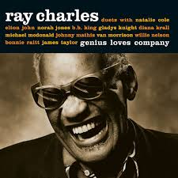
Ray Charles
“So what would Ray Charles say here”?
“Hit the road Jack and don’t you come back no more!”

Slide 40
Plateau of Power/Control (Choices)
The client is struggling with coping with the trauma of being assaulted at gun point, in her apartment by a serial rapist. She wants to work with the police & court system to testify.
What is a musical cognitive interweave that will have a good fit?

Slide 41
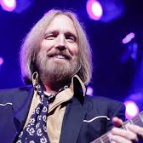
Tom Petty
“I’ll stand my ground……..
And I wont back down….”

Slide 42
Plateau of Power/Control (Choices)
The client is struggling with self esteem, personal growth and wanting to be a better person.
What is a musical cognitive interweave that will have a good fit?

Slide 43
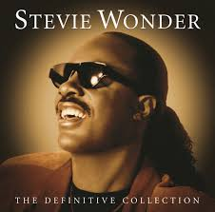
Stevie
Wonder
“Gonna keep on trying, keep on trying till I reach my higher ground.”

Slide 44
Plateau of Safety/Vulnerability
Client is struggling with not feeling fully safe and maintains a strong connection to the past loss of his granddaughter at the mass homicide in Sandy Hook, Connecticut, USA.
What is a musical cognitive interweave that will have a good fit?

Slide 45
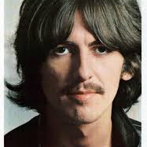
George Harrison
Offer CI, add BLS….
“All things must pass, all things must pass away.”
“What do you get now?

Slide 46

Gloria Gaynor
“I will survive…….
Long as I know how to love.”

Slide 47
Carlos: Plateau of Responsibility
39 year old single man, recently released from five years in federal prison for drug trafficking.
Served 17 months in solitary
His friend was murdered before he went to prison, he became suicidal in prison - Greater New Haven TRN case
Looping, high degree of emotional distress

Slide 48
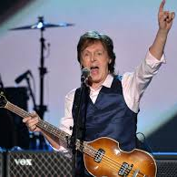
Paul McCartney
“Speaking words of wisdom let it be, let it be.”

Slide 49
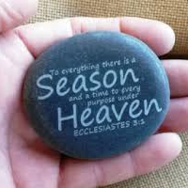
The Bible
Ecclesiastes 3:3
“……..and a time to every purpose under heaven……”
Spiritual cognitive interweave……

Slide 50
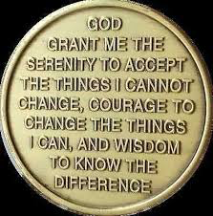
The Serenity Prayer
Alcoholics Anonymous Coin
“God grant me the serenity to accept the things that I can not change, courage to change the things I can and wisdom to know the difference.”

Slide 51
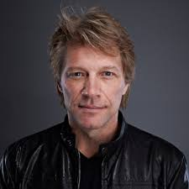
Jon Bon Jovi
“My heart is like an open highway, like Frankie said I did it my way!”

Slide 52
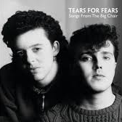
Tears for Fears
“Shout, shout let it all out…..
These are the things I can do without…..”

Slide 53
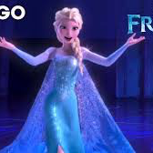
Frozen:
Idina Menzel
“Let it go, let it go…
Can’t hold it back anymore
Let it go, let it go…
Turn away and slam the door.”

Slide 54
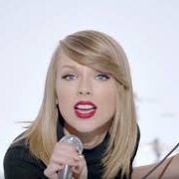
Taylor Swift
“It’s like I got this music in my mind….
Saying its gonna be alright…
Shake it off….”

Slide 55
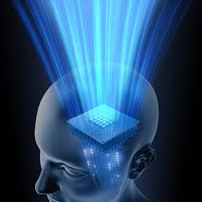
Cognitive Interweave
Practicum
Pick two people to work with
Briefly share a challenging client that you are working with
Write down one empty chair cognitive interweave……………
Write down two cognitive interweaves with one musical and the other spiritual.
Remember the plateaus
Share with the big group in 20 minutes………..

Slide 56
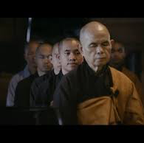
Thich Nhat Hanh
“One Stone”
A one minute mediation using a stone and based on the teaching of the Buddhist monk Thich Nhat Hanh

Slide 57
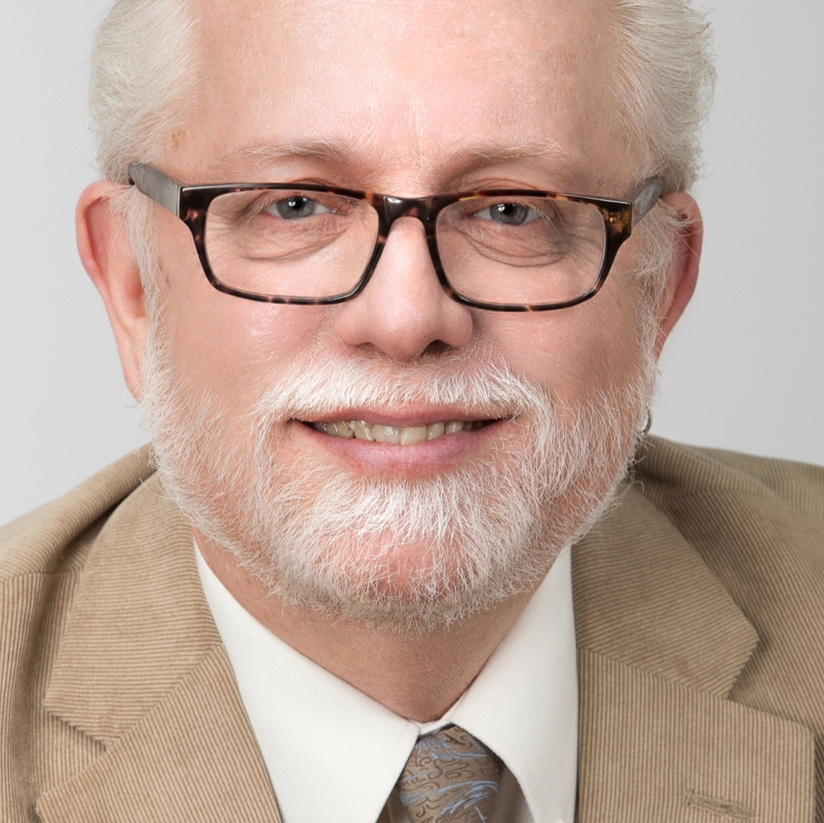
Donald F. deGraffenried, LCSW
The Consultation Center
389 Whitney Avenue
New Haven, Ct. USA
06511
203/675-3179
donald@traumatreat.com

